Slide 1
Bankruptcy Prediction

Slide 2
Project Description
The prediction of bankruptcy is a phenomenon of increasing interest in firms that stand to lose money because of unpaid debts. Since computers can store huge data sets pertaining to bankruptcy, making accurate predictions from them beforehand is becoming important. Company bankruptcy was defined based on the business regulations of the Netherlands (Financial Institution) in this project you will use various classification algorithms on the bankruptcy dataset to predict bankruptcies with satisfying accuracies long before the actual event.

Slide 3
Goal & Objective
This exercise aims to build a model, using historical data that will determine the prediction of bankruptcy.

Slide 4
Approach
In order to execute the project, Python with jupyter notebook was used. notebook was used to import dataset. Once the dataset was imported various sorting and EDA process done and ML Algorithms were used
First I look out if there are any null values and duplicate values then checked correlation of each column with each other. Removed columns having correlation above 90% . Then checked outliers . Since this data is sensitive and in real case 50% bankruptcy is not there hence, no treatment done. Data standardised and then various Machine Learning algorithms implemented.

Slide 5
Tech Stack Used – Jupyter Notebook

Slide 6
Exploratory Data Analysis
Shape of the Data: df.shape gives us number of rows and columns in our data set. Dataset has 6819 rows & 95 columns.
Data Information: df.info() gives us column name, data type, null values and memory usage. Dataset has only 2 categorical columns. And Dataset doesn’t have any null values.
Check for Duplicate Values: df[df.duplicated()] gives duplicate rows. Dataset has zero duplicate row.
Check for Null Values: df.isnull().sum() gives us null values. As we already know dataset doesn’t have null values.
Correlation Matrix: df.corr() gives us correlation matrix, By plotting correlation matrix we can find out multicollinearity. We have removed 19 columns those are highly correlated with each others.
Treatment of Outliers: Here we are not going to remove outlier as it can be important values for our dataset. We are just scaling it using StandardScaler.

Slide 7
Insights (From Next Page)

Slide 8
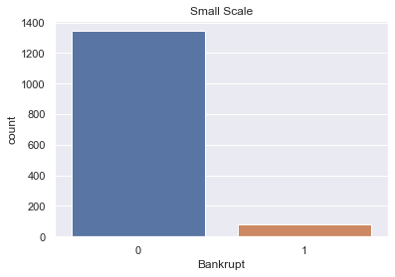
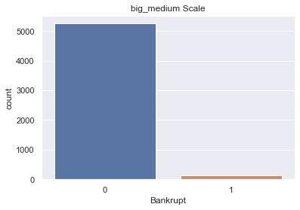
Research & Development Column
There are 1424 firms are from small scale industry because they have 0 expense rate on research & development out which 79 firms are found bankrupt
Whereas 141 from big, medium scale industry are bankrupt

Slide 9
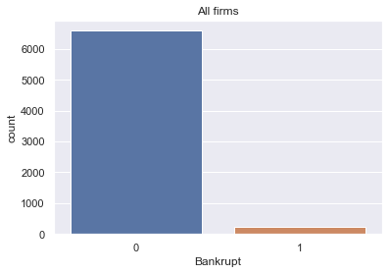
Target Variable Distribution
Our Target variable is Bankrupt.
df.Bankrupt.value_counts() gives us value distribution.
Dataset is highly imbalanced as it contains zero 6599 times and one 220 times.
round(df.Bankrupt.value_counts()/len(df)*100,0) gives us percentage distribution
97% companies are doing great while 3% companies have become bankrupt

Slide 10
Model Building
Balanced data using random oversampler and SVM
Scaled data using Standard Scaler
Build model using Logistics Regression, Decision Tree, Random Forest, XGBoost,KNN, Adaboost, Gradient Boost, Bagging

Slide 11
Result of Models
ML Algorithm | Train Accuracy(%) | Test Accuracy(%)
Logistics Regression | 62 | 62
Decision Tree | 100 | 98
Random Forest | 100 | 99
KNN | 96 | 94
Bagging | 100 | 99
Adaboost Classifier | 94 | 93
XGBoost | 100 | 99
Gradien Boost | 96 | 95
Random Forest is best fit for this project

Slide 12
Final Step
Predicted Dataset which gives expected result
I have added excel file for reference
Kindly click below icon for reference

Slide 13
Conclusion
Total 220 out of 6819 firms are found bankrupt which 3% of total
Even though this no is low still it will impact to individual customer more because bank is able to provide loan when savings get increased. Amount of loan comes from savings made by individual customer.

Slide 14
Suggestions for bank
Try to decrease no of Bankrupt firms as early as possible
For this you can decrease the interest rate on loans provided
If time for repay has been ended then you can extend some time for the firms
Look out for firms financial status for past few years
Check for existence of the firms .

Slide 15
Thank You

